Slide 1
Spineducation iOS Application
Maya Ramamurthy
Katrine Rachitsky
Manaar Hyder
Randa Mohsen

Slide 2

The Problem
After undergraduate training some undergo medical training
Some will pursue further surgical training in orthopedic or neurosurgery
They require a PASS on the royal college examination
The spine remains a source of source of difficulty for many trainees

Slide 3
Background
The number of surgeons required to serve the population are 7 per 100,000 people
Currently there are 5.8 per 100,000
In 2010, there were 5.3 million orthopedic surgeries
In 2020, there will be 6.6 million surgeries required
There are 18,000 active general surgeons in the U.S
Notes:
Since surgeries are increasing, the number of surgeons should also be increasing
We are already at a deficit in terms of surgeons needed, and the number of surgeries required is increasing
Our app will help potential surgeons practice in a virtual environment, learning the theory they need to know and providing the hands-on experience they need to practice

Slide 4
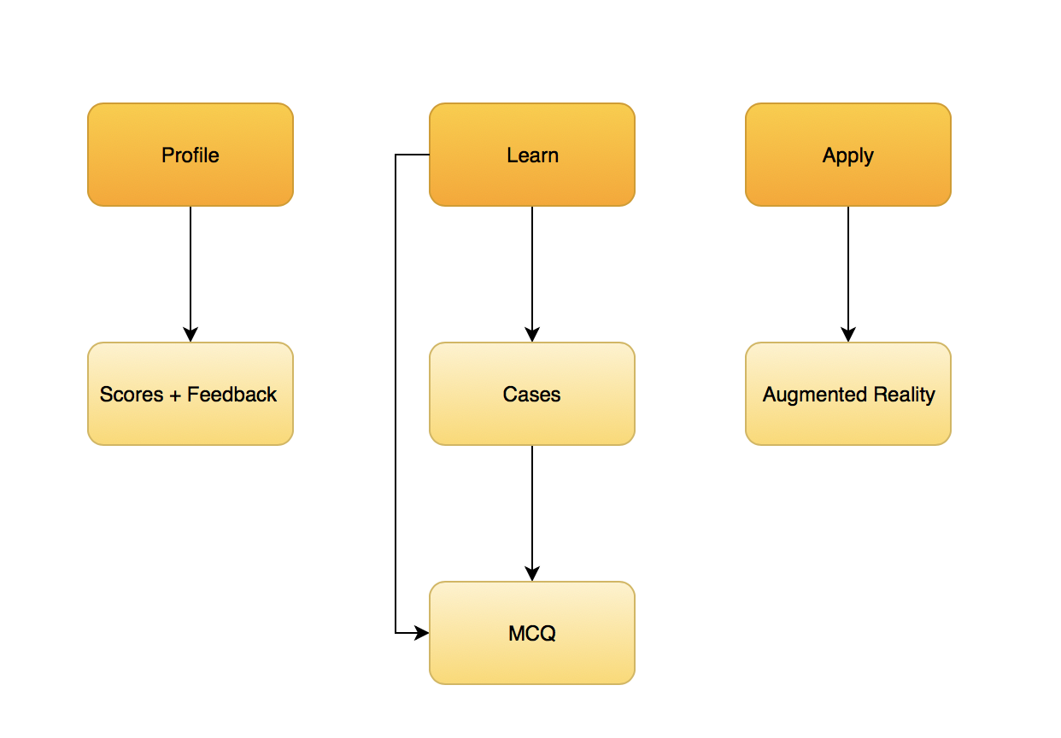
App Flow
Notes:
- Talk as well about data flow

Slide 5
Database tables

Slide 6
Class Hierarchy – Case Studies
ViewController.swift
Imports UIKit, SceneKit, ARKit
Adds 3D models as child node of scene
TouchesBegan() – gets each instance touch
Notes:
For touches Began mention all touch instances – add spine, start point, trajectory, add screw

Slide 7
Class Hierarchy - AR
ViewController.swift
Imports UIKit, SceneKit, ARKit
Adds 3D models as child node of scene
TouchesBegan() – gets each instance touch
Notes:
For touches Began mention all touch instances – add spine, start point, trajectory, add screw

Slide 8
Cases Studies

Slide 9
What Are Medical Cases
Created by Colby Oitment
Hypothetical cases based on real 3D images

Slide 10
What Are Medical Cases
Multiple Choice Questions

Slide 11
How They Are Structured In The App

Slide 12
How It Works
Where data comes from

Slide 13
Obstacles Encountered

Slide 14
Augmented Reality Surgery

Slide 15
3D Models
Existing model customized in Blender and XCode
Rotation, size, texture, material, lighting

Slide 16
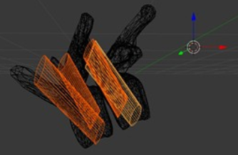
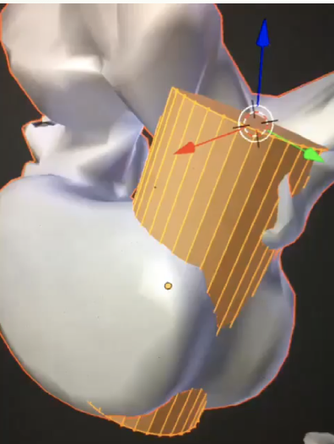
3D Models
Creating Pedicle Cylinders
Created with the help of surgical resident for placement, size and rotation
Act as an indicator for the acceptable region for screw placement

Slide 17
Placing The Spine in AR
When adding an object to SceneView, it is created as a ChildNode of the “root”
The spine is placed by detecting the horizontal plane below
The user is able to re-centre the spine until they are happy with placement

Slide 18
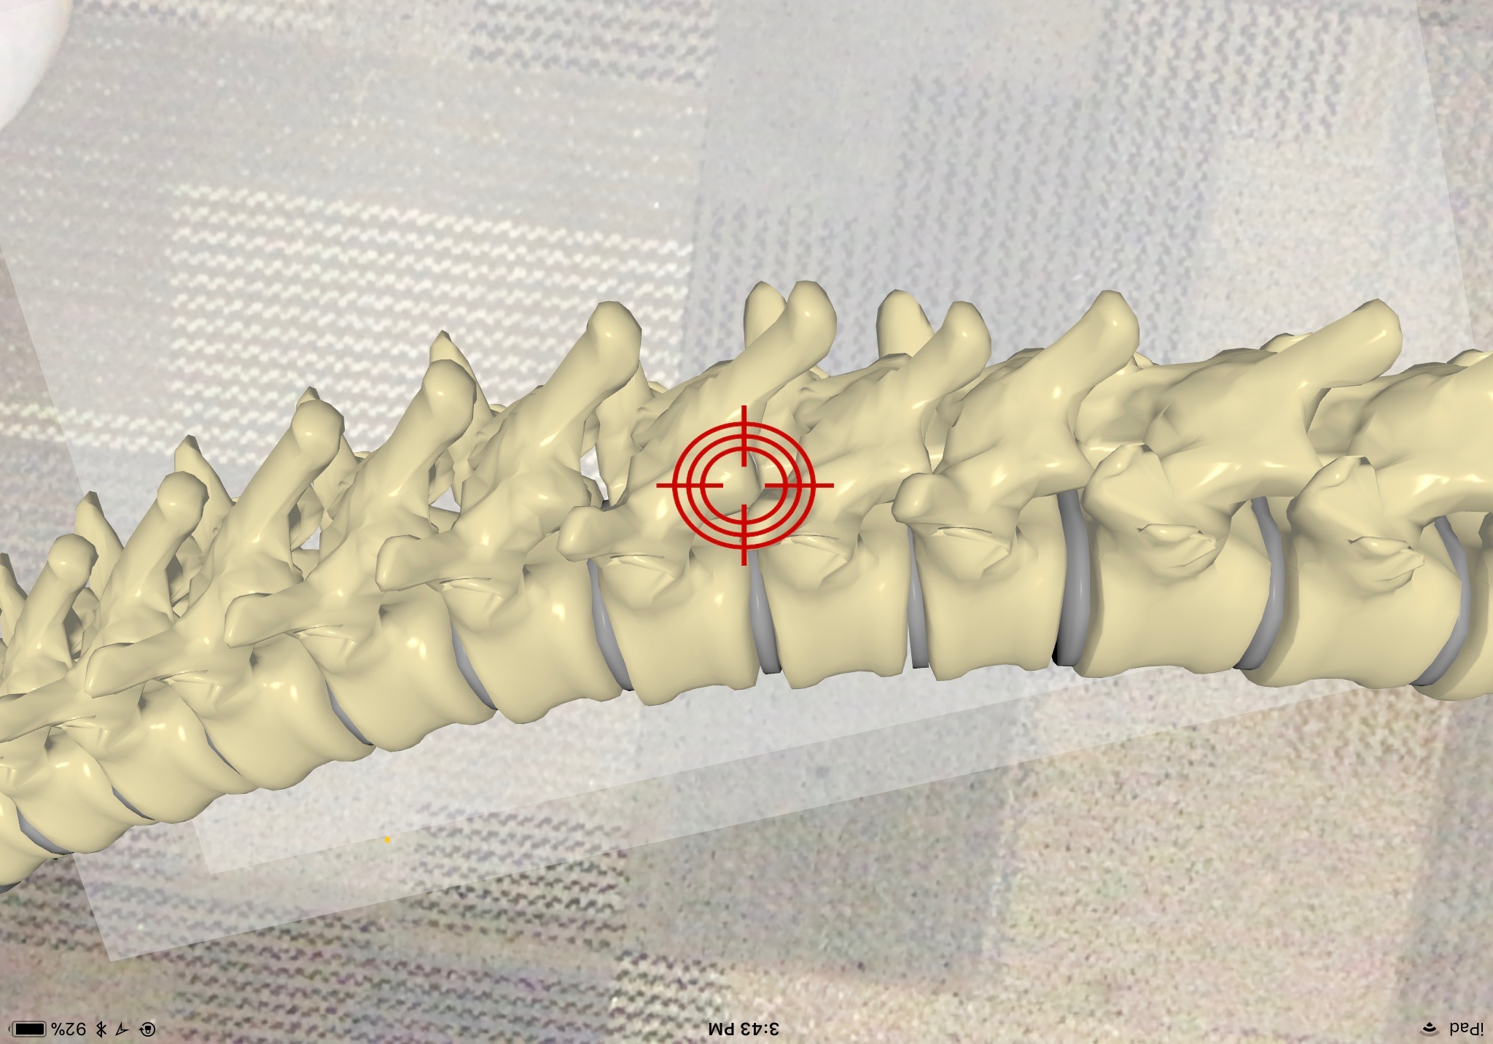
Selection Of Start Points
Node created out of 2D image of bullseye
Added as a node of point of view to follow user movement
User touch indicates camera in position of desired start point, white sphere marks the point chosen
Cylinder used to determine whether or not start point is acceptable

Slide 19
Obtaining Trajectory
Line appears from selected start point to user’s camera
Angle dynamically changes as user changes position of camera
Allows user to select trajectory from start point with which the screw should enter the spine

Slide 20
Screw Placement & Verification
Screw is placed along selected trajectory (based on camera orientation)
Hit test determines whether or not:
The start point coincides with the cylinder
The line intersects the cylinder at the proper angle
This hit test verifies whether or not the user has successfully placed the screw within cylinder and notifies the user

Slide 21
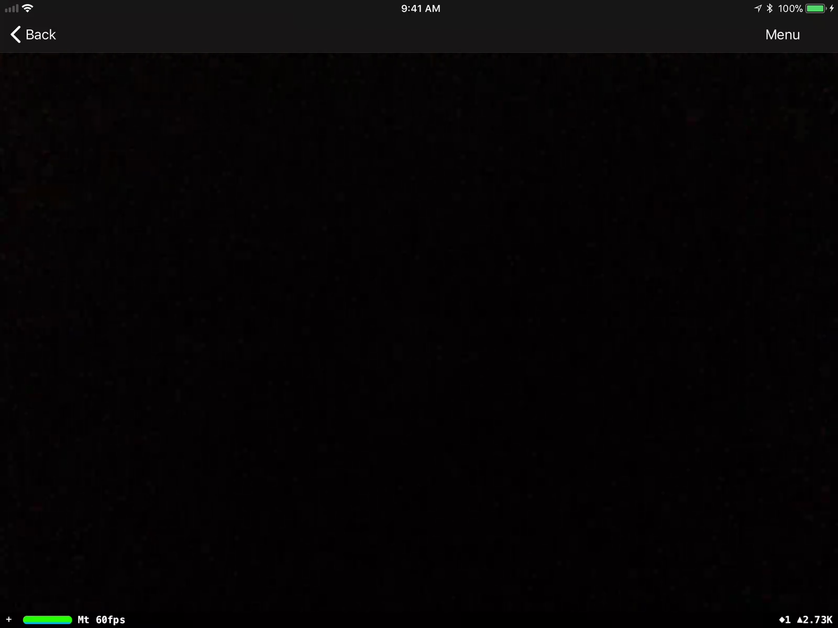
Obstacles Encountered
ARKit limitations
Stabilization of AR Objects
Lack of consistency between hit tests, and translation of coordinates between Real World hit points and AR SceneView points
Camera orientation
Blender and XCode lighting

Slide 22
Demonstration Of Application

